Slide 1
Batteryless and Wireless Data Acquisition System
By:
Corey Cormier, Thomas Ermis, Albert Marzullo, Michael Park, Makeila Sorensen, Anish Vaghasia
With Special Thanks to:
Dr. Valvano, Dr. Pearce, Andrew W., Lucas B., Alex K.
Notes:
Introductions
Here to talk about our project that we worked on over the past year for Senior Design
Really fun project and excited to present

Slide 2
Overview
Design Problem
Design Solution
Design Implementation
Test and Evaluation
Safety and Ethics
Conclusion
Next Steps
Future Applications
Notes:
Intro, Conclusion, Next Steps - Anish
Design Problem - Devin (Talk about the task we were given)
Design Solution - Mike (Give an overview of our 3 module system)
Design Implementation - Corey/Makeila (Go into detail about each of the modules)
Test & Eval - Tom (How we tested our system and what we expected for our final product)
Safety and Ethics - Mike (Talk about the safety considerations of our project)

Slide 3
Design Problem
Overview
Current methods for collecting data from laboratory rats are time consuming and inefficient
Typical experiments require manually taking measurements over and over again over a long period of time
Therefore, our team was responsible for designing system that allows researchers to accurately and efficiently collect data from laboratory rats

Slide 4
Design Problem
Requirements & Constraints
Implant
Biocompatible to not affect the health of the rat
Long lifespan so that it does not need to be replaced
Small so that it can fit comfortably inside of the rat
Measure temperature and acceleration
Batteryless and wireless
System
Relatively quick response time
User-friendly readout

Slide 5
Design Problem
Specifications
Implant
Minimum lifespan: 6 months
Maximum size: 5x5x1 cm³
Accuracy of measurements: 95%
Minimum operating distance: 5 cm
Minimum bandwidth: 1 sample per second
System
Maximum response time: 60 seconds

Slide 6
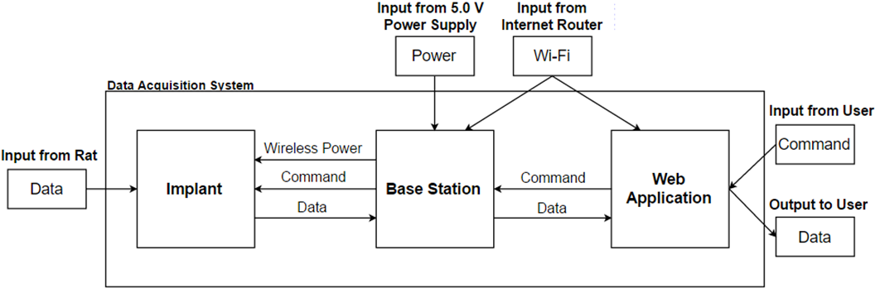
Design Solution
Overview
Built a three part system that consists of an implant, a base station, and a web application (user interface)

Slide 7
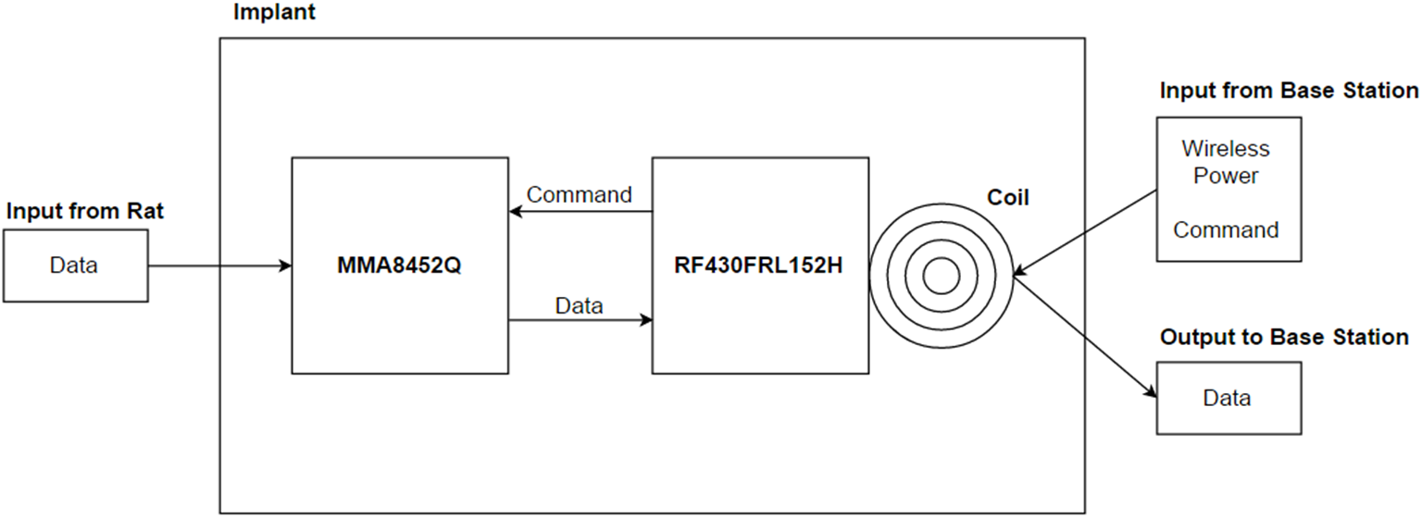
Design Implementation
Implant Block Diagram

Slide 8
Design Implementation
Implant Details
TI RF430FRL152H chip
Wireless power and communication capabilities
Low power consumption < 210µW
14-bit internal temperature sensor
Coil (inductance of 3 µH)
Tuning capacitor to tune the resonant frequency to 13.56 MHz
NXP MMA8452Q accelerometer
Low supply voltage requirements
Low power consumption
12-bit triple-axis acceleration measurements

Slide 9
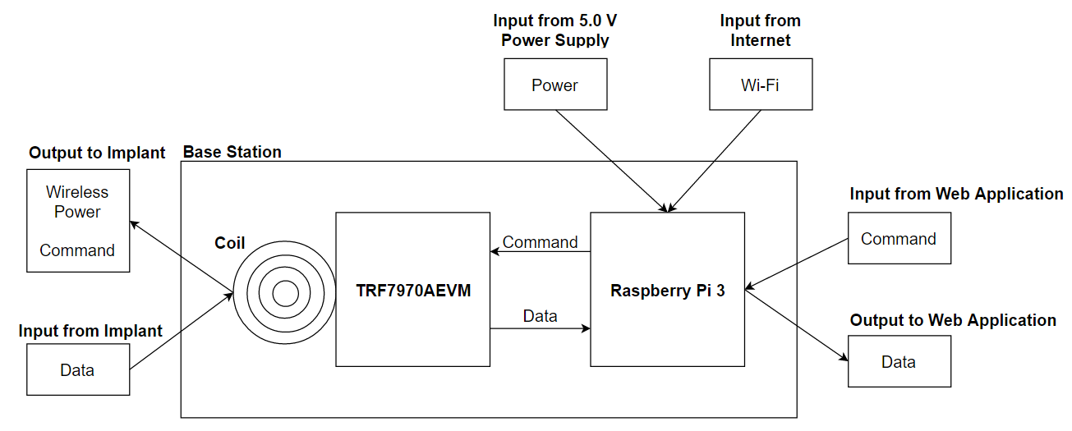
Design Implementation
Base Station Block Diagram

Slide 10
Design Implementation
Base Station Details
TI TRF7970A Evaluation Module
Compatible with the TI RF430FRL152H chip
Readily-available software
Raspberry Pi 3
Built-in Wi-Fi module
Compatible with the IBM Watson Internet of Things Platform

Slide 11
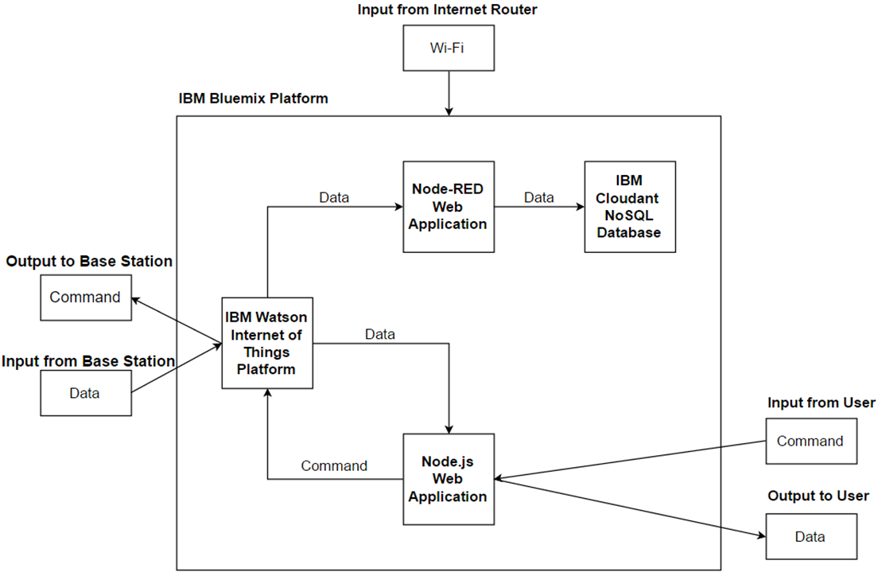
Design Implementation
Web App Block Diagram
Notes:
Thank you Corey.
The third module of our system is the web application.
The primary component of the web application is the Node.js application.
Its purpose is to interface the user with the implant.
For each base-station - implant pair, the user can configure and calibrate the sensors and request data.
When the user requests data, the Node.js application sends a command to the Watson Internet of Things Platform service.
The Watson IoT Platform service then sends the command to the Raspberry Pi component of the base station.
As previously mentioned, there is a script running on the Raspberry Pi that listens for the commands and forwards them on to the TRF component of the base station (and thus the implant).
When the Raspberry Pi receives a response from the TRF, it sends the data back up to the Watson IoT Platform service.
The Watson IoT Platform service sends the data to both a Node-RED flow and the Node.js application.
The Node-RED flow stores the data in a Cloudant NoSQL database, while the Node.js application displays the data to the user.

Slide 12
Design Implementation
Web App Details
IBM Bluemix - offers a robust catalog of application runtimes, services, and APIs
Node-RED - easy integration with services and APIs
Node.js - JavaScript runtime
IBM Watson Internet of Things Platform - connects smart devices to web and mobile applications
IBM Cloudant NoSQL Database - offers powerful data storage and querying
Notes:
The main alternative to a web application is a LCD display. We decided to develop a web application to make it easily accessible, more user-friendly, and scalable to multiple base-station-implant pairs.
In order to build the web application, we leveraged IBM Bluemix.
Bluemix is a cloud platform for developing scalable web and mobile applications.
We decided to use the Bluemix platform because of its robust catalog of application runtimes, services, and APIs.
For the application run times, we selected Node-RED and Node.js.
We chose Node-RED because of its ability to I quickly integrate with various services and APIs.
We chose Node.js because of our familiarity with the JavaScript programming language.
In order to interface the web application with the base station, we selected the IBM Watson Internet of Things Platform service, which allows for efficient and reliable communication between smart devices and applications.
And finally, we selected the IBM Cloudant NoSQL Database service because of its powerful data storage and querying abilities.
And now I will hand it over to Tom, who will explain the testing and evaluation of our system.

Slide 13
Test and Evaluation
Overview
Component
Coils (Inductance)
Module
Implant
Base Station
Web App
System
Data Flow
Functionality (Temperature, Acceleration)
Use Cases
Notes:
We tested for 3 areas, component, module, and system.

Slide 14
Test and Evaluation
Module Testing
Implant
Collection of data (resonant frequency, voltage output)
Wireless transmission to base station (range)
Base Station
Wireless power to the implant (range)
Connection of implant and web application (data transfer)
Web Application
Interface with User, Watson IoT Platform, and Cloudant Database (response time)
User friendly UI (user)
Notes:
THE purpose was <this>, <this> is how we tested to make sure it fulfilled purpose

Slide 15
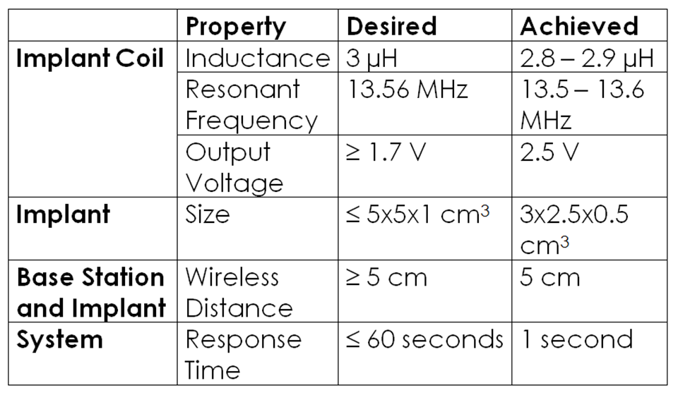
Test and Evaluation
Results

Slide 16
Safety and Ethics
Ethics, Security, and Privacy
Base Station and Web App
Secure communications
Malicious attacks can come from the Internet
(eg) DDoS attacks, Data Theft
Base Station and Implant
Credentials
Base Station user verification (Prevent stealing laboratory data)
Implant
Implant surgery can introduce infections or cause death

Slide 17
Conclusion
Summary
Design Problem
Design Solution & Implementation
Testing and Evaluation
Safety and Ethics
Recommendations
Impact and Future Applications
Notes:
Deliverables: We successfully built a data acquisition system that collects data from a batteryless and wireless implant.

Slide 18
Conclusion
Recommendations
Implant: Design a smaller implant coil
Reduce the size of the implant
Base Station: Design a custom larger coil
Boost the range of wireless power transmission and communication
Web App: Add authentication and improve data storage
Separate users to protect data
Use a relational (SQL) database
Notes:
Recommendations centered around each of the modules
Current situation is _____, then next step _____ would lead to ____

Slide 19
Conclusion
Impact & Future Applications
In addition to laboratory research, our data acquisition system impacts other areas. Additional Applications:
Infrastructure monitoring and alert system
Detect deformations, stress, and other warning signs
Trigger preventative maintenance
Human Diagnostics
Glucose Monitoring
Detect anomalies and trigger preventative care
Notes:
Warning signs: unnatural leaning of building

Slide 20
Q & A

Slide 21
The End

